Slide 1

INCIDENT ANALYSIS - THE MINISTRY
OF THE INTERIOR INTRUSION
Sovereign Data Compromise: Place Beauvau (Dec 17, 2025)
The Event: Silent Exfiltration
Vector: Malicious intrusion into
internal email infrastructure. Initial
access facilitated by compromised
credentials harvested via
Info-stealer malware
(RedLine/Lumma) targeting
administrative staff.
Critical Data at Risk
TAJ Access (Criminal Records):
Attackers recovered access codes for
the Traitement des Antécédents
Judiciaires. Allows consultation of
suspect profiles and victim data.
Attribution: The 'Com' Nexus
The Suspect: 22-year-old individual
'SSRQM' arrested near Limoges.
The Ecosystem: Intelligence links
TTPS to 'The Com'-a convergence of
high-level social engineering groups
(Scattered Spider/Lapsus$) and
state-aligned actors.
FPR Access (Wanted Persons):
Exposure of the Fichier des Personnes
Recherchées.
Dwell Time: Operational indicators
suggest a 'silent' dwell period
allowing for methodical data scraping.
This contrasts sharply with destructive
ransomware TTPs; the objective was
purely espionage.
Profile: Technical sophistication of an
APT combined with the agility of
organized cybercrime.
Impact: Compromise of 'Sovereign
Identity Data' the source of truth
used by the state to verify legal
standing. This data is high-fidelity and
hard to revoke.
Key Takeaway: A 'silent' exfiltration of high-fidelity legal data, executed while security teams were
distracted by concurrent 'noisy' attacks.

Slide 2
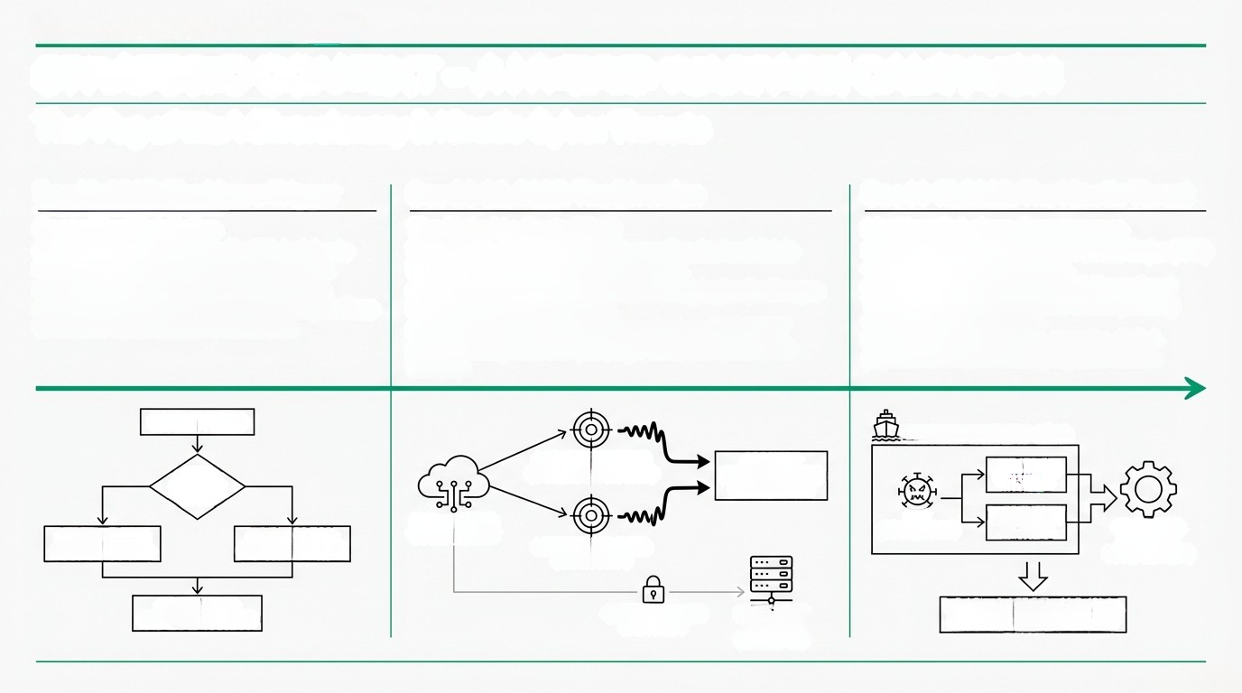
STRATEGIC CONTEXT - A HYBRID WARFARE CAMPAIGN
The 'Fog of War': Diversionary & Kinetic Cyber Threats
Dec 12, 2025: The Macro-Trigger
Dec 22-26, 2025: The Diversion
Dec 14-17, 2025: The Kinetic Threat
Geopolitical Retaliation
Context: Offensive triggered by EU decision to indefinitely freeze Russian sovereign assets.
Doctrine: 'Hybrid Warfare' strategy utilizing simultaneous disruptive and espionage operations to stretch French defensive resources.
The 'Noisy' La Poste DDoS
Vector: Massive DDoS attacks by pro-Russian hacktivists NoName057(16) using 'DDoSia' malware.
Operational Impact: Saturation of banking logins (La Banque Postale) and logistics tracking.
Strategic Function: A smokescreen to draw SOC/CERT attention away from the quiet, high-value data theft at the Ministry.
Maritime Sabotage Convergence
Incident: Discovery of Remote Access Trojan
(RAT) on GNV ferry Fantastic in Séte.
Capability: Malware targeted OT (Operational
Technology) systems, capable of manipulating
navigation and propulsion.
Implication: Willingness to cross the digital-
physical divide, threatening logistics chains.
EU ASSET FREEZE
GNV FERRY "FANTASTIC* (SÈTE)
RUSSIAN
STRATEGIC
RESPONSE
LA BANQUE POSTALE
(BANKING SATURATION)
SOC/CERT
ATTENTION FOCUS
(NOISY EVENT)
NAVIGATION
SYSTEMS
NoName057(16)
'DDoSia' BOTNET
RAT
(OT MALWARE)
PROPULSION
CONTROL
OT SYSTEMS
(PHYSICAL
MANIPULATION)
DISRUPTIVE OPS
(DDOS/SABOTAGE)
ESPIONAGE OPS
(DATA THEFT/INTEL)
LOGISTICS TRACKING
(SATURATION)
STRETCHED FR
DEFENSE RESOURCES
QUIET HIGH-VALUE
DATA THEFT
MINISTRY OF
DEFENSE
(COVERT OP)
THREATENED LOGISTICS CHAINS
(DIGITAL-PHYSICAL CROSSING)

Slide 3
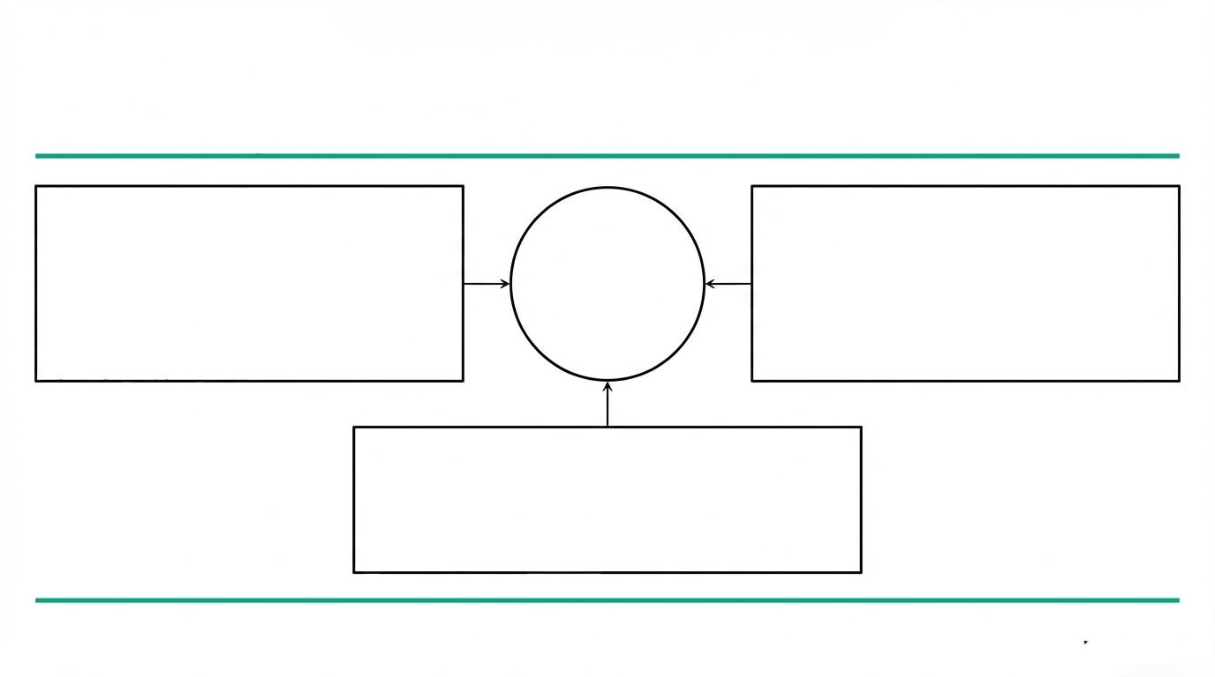
THE DATA ECOSYSTEM RISK – 'THE IDENTITY GRAPH'
Synthesis of Fragmented Data Leaks
Identity Anchors (The Base)
Source: Pass'Sport Breach + CAF Partner Leak
Volume: 6.5M emails/addresses + 22M family records.
Utility: Provides 'lifestyle' data (family composition, benefits status) to validate
social engineering scripts.
Financial Anchors (The Mechanism)
Source: 45M Record 'Data Trove' (Late 2025)
Content: IBANS and BICs tied to French banks. Utility: Allows for direct banking ecosystem injection and Direct Debit fraud.
THE
PERFECT
PROFILE
Verification Anchors (The Seal)
Source: Ministry of Interior (TAJ/FPR)
Content: 'Police Verified' status, legal history, aliases.
Utility: Validates identity against government
databases, defeating negative news checks.
Result: Threat actors are building 'Identity Graphs' that validate a victim's history across social, financial, and legal dimensions. The assumption is that Ministry data is being cross-referenced with concurrent leaks to create 'unflagable' identities.

Slide 4

FINANCIAL FRAUD VECTORS - WEAPONIZING THE BREACH
Downstream Impacts on Banking Fraud
Vector 1: 'Police Verified'
Synthetic Identities
Vector 2: High-Context Social
Engineering (APP Fraud)
Vector 3: Digital Identity Hijacking
Mechanism: Fraudsters use real, 'clean' police data (non-wanted status) to pass Enhanced Due Diligence (EDD).
The Threat: Creation of synthetic profiles that appear government-validated. Accounts are aged (Credit Loading) before a massive 'bust-out'.
Detection Gap: Watchlist checks return 'clear' because the attacker knows exactly who is not on the FPR list.
Mechanism: Criminals pose as police/judicial officers.
The Hook: Attackers cite real case file numbers or judicial blocks obtained from stolen TAJ data.
Success Rate: High fidelity data ('We are freezing your account due to Case #X-123) drastically increases victim compliance in authorizing transfers.
Mechanism: Attempts to hijack La Poste Digital Identity accounts using Ministry data.
Timing: Attacks coincided with DDoS cover; attackers relied on overwhelmed support teams bypassing verification protocols ('Fail-Open' vulnerability).
Impact: Compromise of the primary authenticator used for accessing banking services.

Slide 5

MITIGATION & STRATEGIC RECOMMENDATIONS
Defensive Posture for the Bank
Authentication Hardening
Immediate Action: Migration away from legacy NTLM
protocols (exploited by APT28).
MFA Evolution: Enforce FIDO2/PKI-based Multi-Factor
Authentication for all internal access. SMS-based MFA is insufficient against 'The Com' ecosystem (SIM swapping).
Fraud Detection (Behavioral Biometrics)
The Shift: Static data matching is compromised. A
'correct' match does not equal a legitimate customer.
Implementation: Deploy behavioral biometrics (keystroke dynamics, mouse latency) to detect 'non-human' entry during origination (paste functions/scripts).
The Human Perimeter
Proactive Threat Hunting
Training Update: Flag calls referencing 'judicial blocks' or 'police inquiries' as critical risk indicators.
Verification Protocol: Establish out-of-band verification channels for requests purporting to come from law enforcement.
Intel Requirement: Monitor dark web markets for Info-
stealer logs (RedLine/Lumma) matching employee
credentials.
Graph Analysis: Utilize link analysis to identify clusters of accounts overlapping with known CAF/Pass'Sport leak parameters.

